Slide 1
Tourist-Behaviour-Analysis​
Analysis and Prediction of future tourism demands​
Presented By
Sowmya Patlolla
Sai Sumanth Manam
Sandhya Mamadi

Slide 2
Table of Contents
Introduction​
Methodology​
Results/Outcomes
Challenges​
Future Work
Contribution
References

Slide 3
Introduction
Problem:
The tourism sector is quite dynamic and is impacted by number of variables, including seasonality, the state of the economy, and cultural events. ​
The project's objectives are to analyze the tourist behavior, to identify tourists’ interests and most visited locations and accordingly, and to predict future tourism demands by using the regression models that can precisely forecast visitor arrivals based on historical data. ​
This project's goal is to evaluate a dataset of visitor arrivals in order to pinpoint important trends, seasonal patterns, and variables affecting visitor behavior. ​

Slide 4
Introduction
Solution:
This project uses big data analytics to evaluate vast amounts of data from many sources, including social media platforms, online travel firms, booking systems, and tourist surveys.
By analysing massive volumes of data, this initiative aims to give tourism stakeholders with actionable insights to improve tourist experiences, optimize tourism offers, and boost destination competitiveness.
The regression models can be used to analyse the data, and the time series modelling to generate the future predictions for each month.

Slide 5



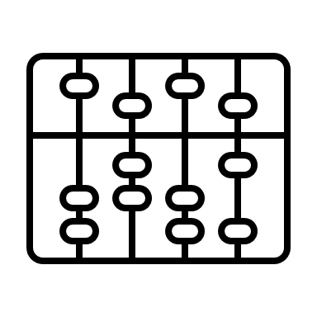


Methodology
Data Collection
Refinement of Dataset
Processing textual metadata
Clustering of geographical data
Prediction of regional trends
Time series modelling

Slide 6
Results/Outcomes
The overall project depicted the use of large no of tourists data for multiple regions across multiple countries.​
The data was cleaned, analyzed, forecasted and used many components to generate some of the meaningful insights.​
Refinement of Data: In this initial step the data was refined to small chunks based on particular region or country.
Textual Metadata Processing: In this step we cleaned the data to remove the stop words, tokenization to make the data more meaningful for further processing in order to get the good insights.​

Slide 7
Results/Outcomes
Geographical Data Clustering : This step generates the Geographical clustering stage output. After running the notebook depicting the code to generate the geographical data clustering, we get the image representing the clusters.​

Slide 8
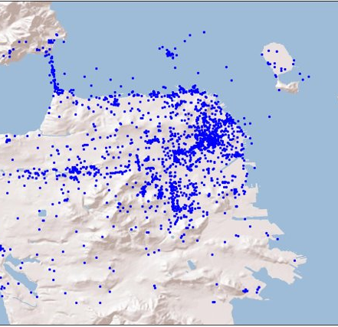
Results/Outcomes
Before Cluster Formation:

Slide 9
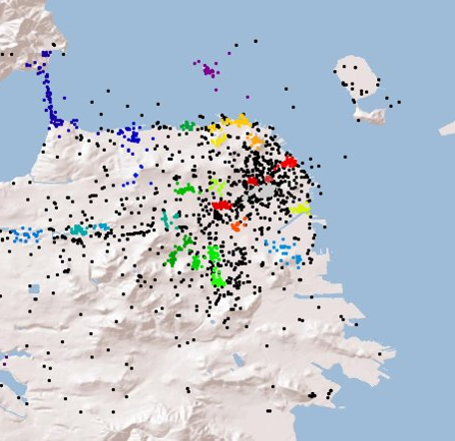
Results/Outcomes
After Cluster formation:
It represents the clusters identified by the HDBSCAN algorithm. Each cluster is assigned a different colour. The data points belonging to each cluster are plotted using the corresponding colour​

Slide 10
Results/Outcomes
Trend Estimation: This steps generated the graph depicting the predicted values (Y_pred) and the actual number of tourists (Ct) which vary over time for particular country.

Slide 11
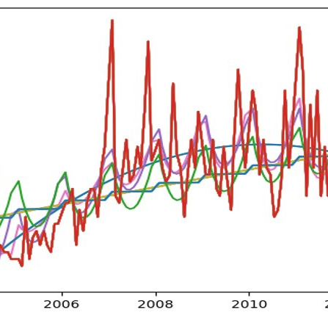
Results/Outcomes
The graph predicts the number of tourists in a specific region, particularly in India. The mean absolute error is also calculated to assess the accuracy of the predictions.​

Slide 12
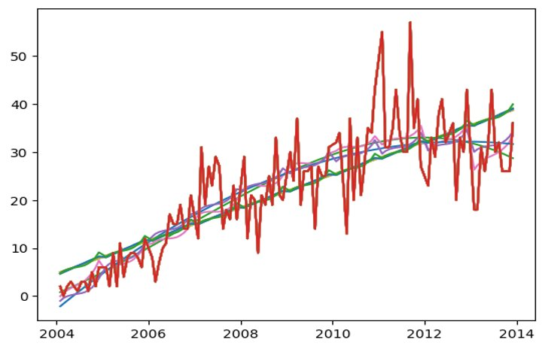
Results/Outcomes
The graph predicts the number of tourists in a specific region, particularly in Australia.​
Red line represents the predictions made by the regression model using the linear regression.​
Blue: Linear regression with polynomial degree 1.​
Orange: Polynomial regression with polynomial degree 3.​

Slide 13
Results/Outcomes
Time Series Modelling: In this final part we applied the time series modelling on the data to provides the region's seasonal trend analysis. It consists of multiple Graphs as described below.

Slide 14
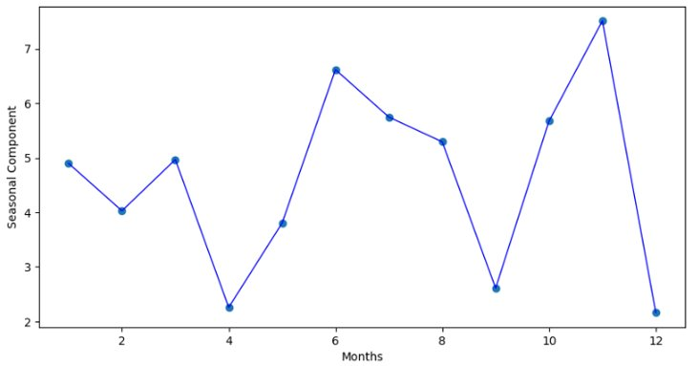
Results/Outcomes
Time Series Component​
The graph below shows the average absolute difference between the actual count of tourists and the predicted count based on the regression models. The y-axis represents the seasonal component, which indicates the deviation of the actual count from the predicted trend.​

Slide 15
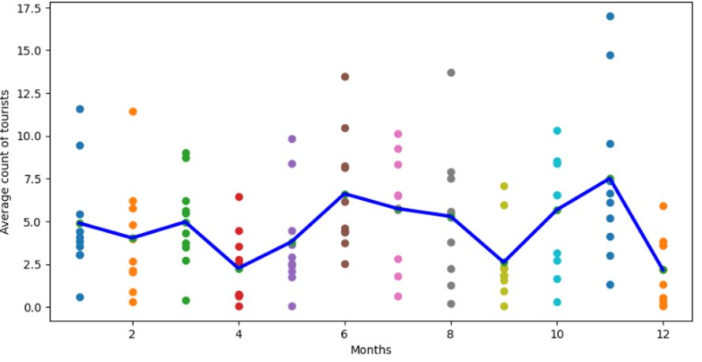
Results/Outcomes
Time Series Output​
The final graph combines both the average count of tourists and the seasonal component in a single plot. The blue line represents the average count of tourists for each month, while the scatter points represent the seasonal component for each month.​
​

Slide 16
Challenges
Data Quality:
The code presently assesses the number of tourists based purely on the dataset provided. External elements such as holidays, events, economic indicators, or weather conditions that may influence tourism patterns should be considered in future studies. This can provide a more complete picture of the factors influencing tourist numbers.
Model Selection:
In our code linear, ridge, and lasso regression models of simple regression were used to estimate trends. It was difficult to choose the right model for a particular dataset, though. After careful consideration and testing we chose the ideal model complexity, consider overfitting or underfitting, and investigated different modelling techniques (such as time series models).

Slide 17
Future Work
The code presently assesses the number of tourists based purely on the dataset provided. External elements such as holidays, events, economic indicators, or weather conditions that may influence tourism patterns that should be considered in future studies. This can provide a more complete picture of the factors influencing tourist numbers.

Slide 18
Contribution
Sowmya: Data collection and refinement to get the clean data for the further processing and analysing.​
​
Sandhya: Geographical Clustering of the data points using the HDBSCAN algorithm and Basemap.​
​
Sai Sumanth: Trend Estimation and time series modelling using linear regression to analyse and predict the tourist trends for a particular region of the country.

Slide 19
References
The dataset utilized in this study is a subset of the YFCC dataset, which may be downloaded at "Yahoo Webscope" (http://webscope.sandbox.yahoo.com).​
Research and usage of HDBSCAN algorithm (https://hdbscan.readthedocs.io/en/latest/index.html)​
Anaconda Python environment manager https://conda.io/docs/user-guide/install/index.html​
Research and Usage of Matplotlib library https://matplotlib.org/

Slide 20
Thank you

